Slide 1
JUnit in the context and JUnit Format
TAN, Shin Hwei 陈馨慧
Southern University of Science and Technology
Slides adapted from cs4218 (NUS)
Credits: Konstantin Rubinov

Slide 2
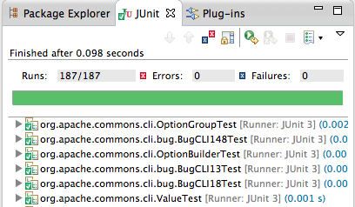
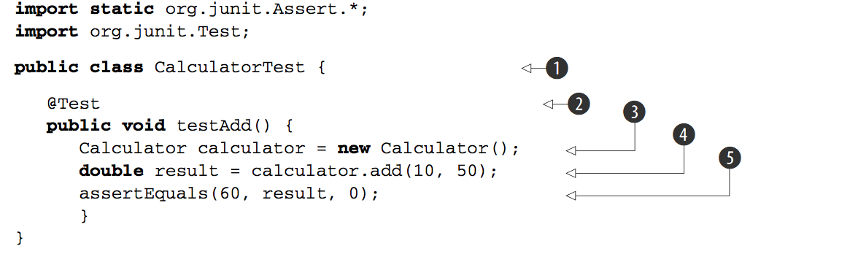
JUnit is a format and a framework
for Java programs
by Erich Gamma and Kent Beck
for specifying and executing test cases
automatically

Slide 3
JUnit is a format and a framework
for Java programs
by Erich Gamma and Kent Beck
JUnit Framework is integrated into Eclipse through a graphical plug-in and it provides a set of classes and conventions

Slide 4
JUnit test cases are Java code

Slide 5

Why JUnit?

Slide 6
Developer testing is more advanced and simpler than println-ing
Why JUnit?
Naturally supports continuous testing
Aids fault localization
Automates test execution process

Slide 7
Developer testing is more advanced and simpler than println-ing
Why JUnit?
Aids alternative thinking about system under test
Is a software specification (intended behavior)
Consolidates test results and execution statistics

Slide 8
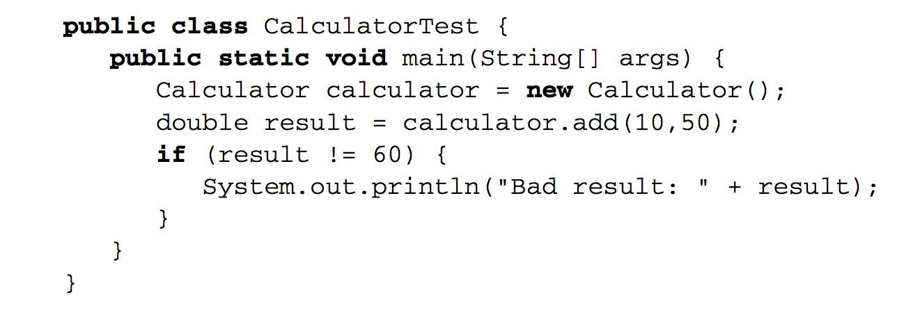
JUnit testing
vs.
Println-ing

Slide 9
JUnit testing
vs.
Println-ing
unnecessary main() method
placing and then removing ‘System.out.println(...)’
inspecting output manually

Slide 10
JUnit testing
appropriate use of main() method
automatic test execution and generated reports
no need for manual inspection
vs.
Println-ing
unnecessary main() method
placing and then removing ‘System.out.println(...)’
inspecting output manually

Slide 11

String Wrapper testing:
/**
* Purpose: program for wrapping strings on spaces and
indenting strings if we break them before '+' or '=' symbols as in Java.
*/
public class Wrapper {
public String wrap(String s, int length) {
...
}
}
‘Developer testing’ perspective helps to see system behavior in new ways

Slide 12
@Test
public void testWrapNull() {
assertEquals("", wrapper.wrap(null, 10));
}
@Test
public void ThreeWordsOverTheLimitShouldWrapAtSecondWord() {
assertEquals("word word\nword", wrapper.wrap("word word word", 5));
}
@Test
public void TwoWordsLongerThanLimitShouldNotWrap() {
assertEquals("word word", wrapper.wrap("word word", 6));
}

Slide 13

@Test
public void testWrapNull() {
assertEquals("", wrapper.wrap(null, 10));
}
@Test
public void ThreeWordsOverTheLimitShouldWrapAtSecondWord() {
assertEquals("word word\nword", wrapper.wrap("word word
word", 5));
}
@Test
public void TwoWordsLongerThanLimitShouldNotWrap() {
assertEquals("word word", wrapper.wrap("word word", 6));
}
@Test
public void testWrapConsequtiveSpaces() {
assertEquals(" ", wrapper.wrap(" ", 2));
}
How should we wrap a string of spaces?

Slide 14

@Test
public void testWrapNull() {
assertEquals("", wrapper.wrap(null, 10));
}
@Test
public void ThreeWordsOverTheLimitShouldWrapAtSecondWord() {
assertEquals("word word\nword", wrapper.wrap("word word word", 5));
}
@Test
public void TwoWordsLongerThanLimitShouldNotWrap() {
assertEquals("word word", wrapper.wrap("word word", 6));
}
@Test
public void testWrapConsequtiveSpaces() {
assertEquals(" ", wrapper.wrap(" ", 2));
}
JUnit test case as a specification of intended behavior

Slide 15
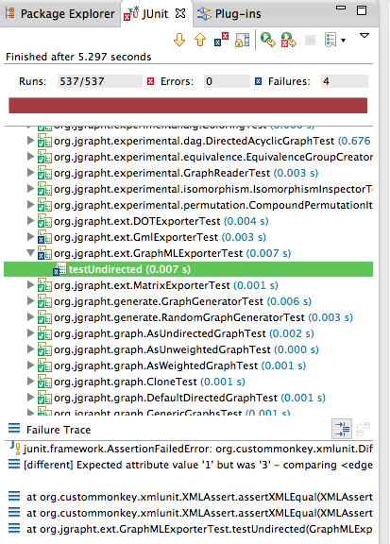
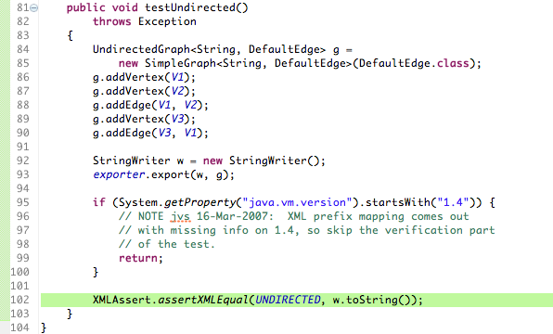




Fault localization

Slide 16

Execution time
Failures/Errors
Stack traces
Contrast expected and actual
Consolidate results and provide statistics

Slide 17
Failure vs. Error
Failure: if assertion is violated
Error: compilation problems, unexpected exception

Slide 18
Elements of a Test case

Slide 19
@test method

Slide 20
Methods annotated with @Test are executed by JUnit
@Test
public void testWrapNull() {
Wrapper wrapper = new Wrapper();
String result = wrapper.wrap(null, 10);
assertEquals("", result);
}

Slide 21

Logical structure
What? When?
Then...
Object under test
Method under test with parameters
Comparison of expected and actual data
Logic:
@Test
public void testWrapNull() {
Wrapper wrapper = new Wrapper();
String result = wrapper.wrap(null, 10);
assertEquals("", result);
}
What? When?
Then...

Slide 22

assert:
a family of methods to check conditions
assertEquals("", result);
“check if
expected and
actual values are equal”
@Test
public void testWrapNull() {
Wrapper wrapper = new Wrapper();
String result = wrapper.wrap(null, 10);
assertEquals("", result);
}

Slide 23
assert:
a family of methods to check conditions
assertEquals("", result);
“check if
expected and
actual values are equal”
If assertion fails (checked condition is not satisfied):
current test is marked as ‘failed’
JUnit skips execution of the rest of the test method and proceeds executing remaining test methods

Slide 24
assert
for a boolean condition:
assertTrue(“message for fail”, condition);
assertFalse(“message”, condition);
for object, int, long, and byte values, array:
assertEquals(expected_value, expression);
for float and double values:
assertEquals(expected, expression, error);
for objects references:
assertNull(obj_ref)
assertNotNull(obj_ref)
assertSame(obj_ref, obj_ref2)
...

Slide 25
assert: example
@Test
public void testPush() {
Stack aStack = new Stack();
assertTrue("Stack should be empty!",
aStack.isEmpty());
aStack.push(10);
assertFalse("Stack should not be empty!",
aStack.isEmpty());
aStack.push(4);
assertEquals(4, aStack.pop());
assertEquals(10, aStack.pop());
}

Slide 26

assert: better example
@Test
public void testStackEmpty() {
Stack aStack = new Stack();
assertTrue(“Stack should be empty!”, aStack.isEmpty());
aStack.push(10);
assertFalse(“Stack should not be empty!”, aStack.isEmpty());
}
@Test
public void testStackOperations() {
Stack aStack = new Stack();
aStack.push(10);
aStack.push(-4);
assertEquals(-4, aStack.pop());
assertEquals(10, aStack.pop());
}
Separate @Test methods for testing individual scenarios and methods

Slide 27
assertEquals vs. assertSame
for values:
assertEquals(expected_value, expression);
assertEquals(expected, expression, error);
for objects references:
assertSame(obj_ref, obj_ref2)
Important distinction:
assertEquals() and assertSame() are used for different purposes
careful when comparing Strings

Slide 28

assertEquals vs. assertSame
@Test
public void testEquality() {
String a = "abcde";
String b = new String(a);
assertTrue(a.equals(b));
assertFalse(a == b);
assertEquals(a, b);
String c = "abcde";
assertNotSame(a, b);
assertSame(a,c);
}
Will the test fail?
Where?
Important distinction:
assertEquals() and assertSame() are used for different purposes
be prudent when comparing Strings

Slide 29

Test class
TestMethod ∈ TestClass

Slide 30
Test class
public class ListTest {
protected List<Integer> fEmpty;
protected List<Integer> fFull;
protected static List<Integer> fgHeavy;
@BeforeClass
public static void setUpOnce() {
fgHeavy = new ArrayList<Integer>();
for (int i = 0; i < 1000; i++) {
fgHeavy.add(i);
}
}
@Before
public void setUp() {
fEmpty = new ArrayList<Integer>();
fFull = new ArrayList<Integer>();
fFull.add(1);
fFull.add(2);
fFull.add(3);
}
@Test
public void testCopy() {
List<Integer> copy = new ArrayList<Integer>(fFull.size());
copy.addAll(fFull);
assertTrue(copy.size() == fFull.size());
assertTrue(copy.contains(1));
}
@Test(expected = IndexOutOfBoundsException.class)
public void elementAt() {
int i = fFull.get(0);
assertTrue(i == 1);
fFull.get(fFull.size()); // Should throw IndexOutOfBoundsException
}
@Test
public void removeAll() {
fFull.removeAll(fFull);
fEmpty.removeAll(fEmpty);
assertTrue(fFull.isEmpty());
assertTrue(fEmpty.isEmpty());
}
}
A public class that aggregates @Test methods and special auxiliary JUnit methods (setup and tear-down)

Slide 31

@Test
public void testCopy() {
List<Integer> copy = new ArrayList<Integer>(fFull.size());
copy.addAll(fFull);
assertTrue(copy.size() == fFull.size());
assertTrue(copy.contains(1));
}
@Test(expected = IndexOutOfBoundsException.class)
public void elementAt() {
int i = fFull.get(0);
assertTrue(i == 1);
fFull.get(fFull.size()); // Should throw IndexOutOfBoundsException
}
@Test
public void removeAll() {
fFull.removeAll(fFull);
fEmpty.removeAll(fEmpty);
assertTrue(fFull.isEmpty());
assertTrue(fEmpty.isEmpty());
}
@Test methods

Slide 32
public class ListTest {
protected List<Integer> fEmpty;
protected List<Integer> fFull;
protected static List<Integer> fgHeavy;
@Before
public void setup() {
fEmpty = new ArrayList<Integer>();
fFull = new ArrayList<Integer>();
fFull.add(1);
fFull.add(2);
fFull.add(3);
}
@After
public void tearDown() {
fFull = null;
....
}
Setup methods prepare common objects/resources for test execution
Tear-down methods release common objects/resources after test execution
Auxiliary setup and tear-down methods
@Before
@After

Slide 33


public class ListTest {
protected List<Integer> fEmpty;
protected List<Integer> fFull;
protected static List<Integer> fgHeavy;
@BeforeClass
public static void setUpOnce() {
fgHeavy = new ArrayList<Integer>();
for (int i = 0; i < 1000; i++) {
fgHeavy.add(i);
}
}
@Before
public void setUp() {
fEmpty = new ArrayList<Integer>();
fFull = new ArrayList<Integer>();
fFull.add(1);
fFull.add(2);
fFull.add(3);
}
setup
executed once for a test class
executed before every test method
Aid code reuse - extract common object creation/release from test methods

Slide 34
@Test
public void contains() {
assertTrue(fFull.contains(1));
assertTrue(!fEmpty.contains(1));
}
@Test
public void removeAll() {
fFull.removeAll(fFull);
fEmpty.removeAll(fEmpty);
assertTrue(fFull.isEmpty());
assertTrue(fEmpty.isEmpty());
}
If removeAll() test case is executed first, then contains() test case will give wrong results!
Caution: common objects may cause unwanted dependence between test methods

Slide 35
@Test
public void contains() {
assertTrue(fFull.contains(1));
assertTrue(!fEmpty.contains(1));
}
@Test
public void removeAll() {
fFull.removeAll(fFull);
fEmpty.removeAll(fEmpty);
assertTrue(fFull.isEmpty());
assertTrue(fEmpty.isEmpty());
}
If removeAll() test case is executed first, then contains() test case will give wrong results!
Caution: common setup/tear-down may cause unwanted dependence between test methods

Slide 36

@Test
public void contains() {
assertTrue(fFull.contains(1));
assertTrue(!fEmpty.contains(1));
}
@Test
public void removeAll() {
fFull.removeAll(fFull);
fEmpty.removeAll(fEmpty);
assertTrue(fFull.isEmpty());
assertTrue(fEmpty.isEmpty());
}
If removeAll() test case is executed first, then contains() test case will give wrong results!
It is a developer (your) responsibility to make sure test methods are isolated from each other!
Caution: common setup/tear-down may cause unwanted dependence between test methods

Slide 37


TestClass ∈ TestSuite
@RunWith(Suite.class)
@SuiteClasses({CSVRendererTest.class, EmacsRendererTest.class, XMLRendererTest.class, TextPadRendererTest.class})
public class RenderersTests {
}
Allows grouping test classes in different sets for test execution
Special JUnit runner
-> org.junit.runners.Suite.class

Slide 38
Test of “Exceptions”
There are two cases:
We expect a normal behavior and then no exceptions.
We expect an anomalous behavior and then an exception.

Slide 39
We expect a normal behavior …
try {
// We call the method with correct parameters
object.method("Parameter");
assertTrue(true); // OK
} catch(PossibleException e){
fail(“method should not fail !!!");
}
class TheClass {
public void method(String p)
throws PossibleException
{ /*... */ }
}

Slide 40
We expect an exception …
try {
// we call the method with wrong parameters
object.method(null);
fail(“method should fail!!");
} catch(PossibleException e){
assertTrue(true); // OK
}
class TheClass {
public void method(String p)
throws PossibleException
{ /*... */ }
}

Slide 41
Do you know about what is it called when two programmers work together at one workstation in agile?
Pair Programming

Slide 42
Let's try “Pair Testing”
Lab exercise

Slide 43
Simple TriType Example
TriTyp: Given three integers for the lengths of the sides of a triangle, find the type of triangle
Try testing the “Triang(int, int,int)” method
Go to this link to get the program:
https://classroom.github.com/g/trrjQPYs
This is an graded (passed/failed) lab assignment. You get full score as long as you accept the invitation link and commit your test (“TriTypTest.java” file) at the last step.

Slide 44
Pair Testing
Form a team of two with your neighbors
Write two JUnit tests for TriTyp individually
Write two JUnit tests for TriTyp to check for corner/boundary cases individually
Compile & run your tests & theory to see if they are passing
Show all your tests to your teammate and try the following:
Convince your teammate that your tests are better
Convince your teammate that your tests are testing different behavior than his/her tests
Convince your teammate that your tests are of the same quality
Let your teammate knows if you feel that his/her test is better
Combine all the final tests and save as “TriTypTest.java” file. Commit the file to GitHub.

Slide 45
How many tests you have now?
2 JUnit Tests?
3 JUnit Tests?
4 JUnit Tests?
> 4 JUnit Tests?

Slide 46
How can unit tests help?
Watch the video on how to start working on open-source project (use tests to help you)
International student:
https://www.youtube.com/watch?v=k1T5Wbx0NMw
Local student: https://www.bilibili.com/video/BV1dc411h7VH

Slide 47

How can unit tests help?

